Slide 1
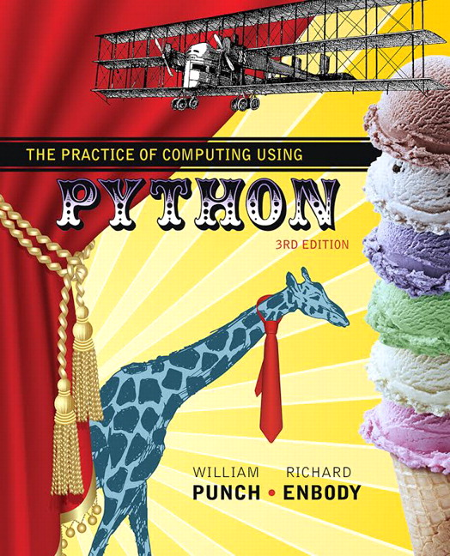
The Practice of Computing Using Python
Third Edition
Chapter 0
The Study of Computer Science
Copyright © 2017, 2013, 2011 Pearson Education, Inc. All Rights Reserved
Notes:
If this PowerPoint presentation contains mathematical equations, you may need to check that your computer has the following installed:
1) MathType Plugin
2) Math Player (free versions available)
3) NVDA Reader (free versions available)

Slide 2
What is Computer Science?

Slide 3
Definition
Computer science is a discipline that involves the understanding and design of computers and computational processes.

Slide 4
A Well-Educated Computer Scientist Should Be Able To...
Apply the fundamental concepts and techniques of
Computation,
Algorithms, and
Computer design
To a specific problem

Slide 5
Including
Detailing of specifications,
Analysis of the problem,
Provide a design that
Functions as desired,
Has satisfactory performance,
Is reliable and maintainable,
And meets desired cost criteria.

Slide 6
Aspects of Computer Science
Theory of computation
Computational Efficiency
Algorithms and Data Structures
Parallel Processing
Software Engineering
Others

Slide 7
Our Goals
Our goals are not to just write copious amounts of code, our goals are to:
Increase our problem solving skills
Design good solutions to problems
Test somehow how well they are indeed solutions to the problem
Provide the solution as a readable document

Slide 8
Why is this Hard?
I cannot precisely explain why it is hard, only that it is indeed hard.
Typically quote is “Never have I worked so hard and gotten so low a grade”

Slide 9
An Analogy
Let us say that you have signed up to study French poetry (how about Marot) in the original
You have two problems:
You don’t speak french
You don’t know much about poetry

Slide 10
Clement Marot 1496-1544 (1 of 4)
Ma mignonne
Je vous donne
Le bon jour;
Le séjuour
C’est prison.
Guérison
Recouvrez,
Puis ouvrez

Slide 11
Clement Marot 1496-1544 (2 of 4)
Votre porte
Et qu’on sorte
Vitement,
Car Clément
Le vous mande.
Va, friane
De ta bouche,
Qui se couche

Slide 12
Clement Marot 1496-1544 (3 of 4)
En danger
Pour mange
Confitures;
Si tu dures
Trop malade,
Couleur fade
Tu Prendras,
Et perdras

Slide 13
Clement Marot 1496-1544 (4 of 4)
L’embonpoint.
Dieu te doint
Santé bonne,
Ma mignonne.

Slide 14
Crappy-literal Translation (1 of 4)
My sweet/cute [one] (feminine)
I [to] you (respectful) give/bid/convey
The good day (i.e., a hello, i.e., greetings).
The stay/sojourn/visit (i.e., quarantine)
[It] is prison.
Cure/recovery/healing (i.e., [good] health)
Recover (respectful imperative),
[And] then open (respectful imperative)

Slide 15
Crappy-literal Translation (2 of 4)
Your (respectful) door,
And [that one (i.e., you (respectful)) should} go out
Fast[ly]/quick[ly]/rapid[ly],
For/because Clement
It (i.e., thusly) [to] you(respectful) commands/orders.
Go (familiar imperative), fond-one/enjoyer/partaker
Of your (familiar) mouth,
Who/which herself/himself/itself beds (i.e., lies down)

Slide 16
Crappy-literal Translation (3 of 4)
In danger;
For/in-order-to eat
Jams/jellies/confectionery.
If you (familiar) last (i.e., stay/remain)
Too sick/ill,
[A] color pale/faded/dull
You )familiar) will take [on],
And [you (familiar)] will waste/lose

Slide 17
Crappy-literal Translation (4 of 4)
The plumpness/stoutness/portliness (i.e., well-fed look).
[may] God [to] you (familiar) give/grant
Health good,
My sweet/cute [one] (feminine).

Slide 18
Decent Trans, S.Jamar (1 of 5)
My sweet dish,
You I wish
A good day.
Where you stay,
Is a jail.
Though so pale,
Leave your bed,
Regain red.

Slide 19
Decent Trans, S.Jamar (2 of 5)
Ope’ your door
Stay not, poor
Child; gain strength
And at length,
Steve does urge,
Please emerge.
Then go eat
Jam so sweet.

Slide 20
Decent Trans, S.Jamar (3 of 5)
Ope’ your door
Stay not, poor
Child; gain strength
And at length,
Steve does urge,
Please emerge.
Then go eat
Jam so sweet.

Slide 21
Decent Trans, S.Jamar (4 of 5)
Lying ill
Means you will
become too thin -
Merely skin
Cov’ring bone;
Regretted tone.
Eat again,
Avoid the fen.

Slide 22
Decent Trans, S.Jamar (5 of 5)
God grant thee
Be healthy.
This I wish,
My sweet dish.

Slide 23
How Does this Apply
You have two related problems:
the syntax of French is something you have to learn
the semantics of poetry is something you have to learn
You have two problems you have to solve at the same time.

Slide 24
Programming, Syntax and Semantics
You have to learn the syntax of a particular programming language
many details about the language, how to debug and use it
You have to learn about problem solving and how to put it down on computer.
There probably is no better way. It’s hard!

Slide 25
Computers and Problem Solving?
This is both the problem and difficulty of computers.
The promise (perhaps the hope) of computers is that, somehow, we can embed our own thoughts in them. To some extent we can!
The problem is the difficulty of doing so, and the stringent requirements, the real rigor, required to put simple thoughts into a working program.

Slide 26
Focus of Computer Science
There are two foci for computer science
Learning the difficult task of truly “laying out” a problem-solving task
Providing tools to make this process as easy (though it will never be “easy”) as possible.
Your focus should be on problem-solving, and adding rigor/focus to your ability to do problem-solving.

Slide 27
Good Program (1)
What makes a good program?
A program is a reflection of the writer and their thoughts
First, you must have some thoughts! The difficulty for most people is to figure out what has to be done, the problem solving, before writing a program

Slide 28
Rule 1
Think before you program!

Slide 29
Good Program (2)
It will be said repeatedly that the goal of a program is not to run, but to be read.
A program communicates with other people as well. It stands as a document to be read, repaired and, yes, run

Slide 30
Rule 2
A program is a human-readable essay on problem solving that also happens to execute on a computer.

Slide 31
Why Python?
This book utilizes the programming language known as Python.
Why?

Slide 32
Why Python (1): Simpler
Python is a simpler language
Simpler means:
Fewer alternatives (one way to do it)
Better alternatives (easier to accomplish common tasks)
This allows us to focus less on the language and more on problem solving

Slide 33
Why Python (2): Best Practices
Many of the best parts of other languages are included in Python
Data structures (lists, dictionaries)
Control (iteration, exceptions)
Many packages for common tasks
Python is often described as “batteries included”

Slide 34
Why Python (3): User base
While we want to (and will) teach the fundamentals of computer science, we want what you learn to be useful
Python is Open Source:
Freely available
Large user base constantly contributing
New packages available to meet changing needs

Slide 35
Why Python (4): Useful
As a result, Python is more generally useful for getting work done.
One course in Python makes you a capable (though not expert) programmer
Can use available packages and your new skill to solve problems.

Slide 36
Computational Thinking
Having finished this course, we want you to have the following thought in your subsequent college career.
“Hey, I’ll just write a program for that”. For us, that is “computational thinking”
Python allows this to happen more readily.

Slide 37
Is Python the Best Language?
The answer is no. This is because there is no best language.
Computer languages, like tools, are suited for different tasks (what’s the best shovel? Depends on what you are doing).
For introductory students, we think Python is a very good language.

Slide 38
What is a Computer?

Slide 39
Computer as a Toaster
50 years ago when computers came into common existence, they were expensive, rare items used for research.
Today they are as common as a toaster (likely more common, do you own a toaster?)
Good to know a little bit about your toaster

Slide 40
Computers do Computation
Kind of obvious, but a computer is something that does computation.
What’s interesting is what counts as computation

Slide 41
Human Brain
In the 1960’s, when computers were becoming more prevalent, they were commonly called “electronic brains”
However, the brain as a computer as very little in common with the modern computer (except that they both do computation).

Slide 42
Neuron (1 of 2)
The human brain consists of on the order of 100 billion (1011) small cells called neurons
Neurons have a simple task, to act as a kind of switch

Slide 43
Neuron (2 of 2)
Figure 0.3 An annotated neuron. [S E E R Training Modules, U.S. National Institutes of Health, National Cancer Institute].

Slide 44
Transmission of signal
A neuron “fires”, sends a signal, when enough chemical transmitters accumulate at its dendrites.
When it fires, the signal, as a chemical/electrical impluse moves down the axon
When the signal reaches the terminals, more chemical transmitters are released to other neurons.

Slide 45
Interesting Facts
Signal transmission is very slow
Millions times slower than a computer
Neuron’s require recovery time before they can fire again.
What causes a firing depends on the number of signals it receives at its dendrites and how fast they arrive.
That is, it depends on the number of connections.

Slide 46
Evolution as Computation
There is an entire field devoted to the use of the principles of Darwin and Mendel to solve a problem: evolutionary computation
Evolution focuses on solving a problem by generating solutions (i.e. organisms) that adapt to the present environment

Slide 47
Evolutionary Computation
Figure 0.4 A genetic algorithm.

Slide 48
Facts
maintains a population of solutions
Solutions are an encoding of the problem
Each solution is evaluated
Good solutions tend to be used to create new solutions, variations on themselves
Over time, the population contains better and better solutions

Slide 49
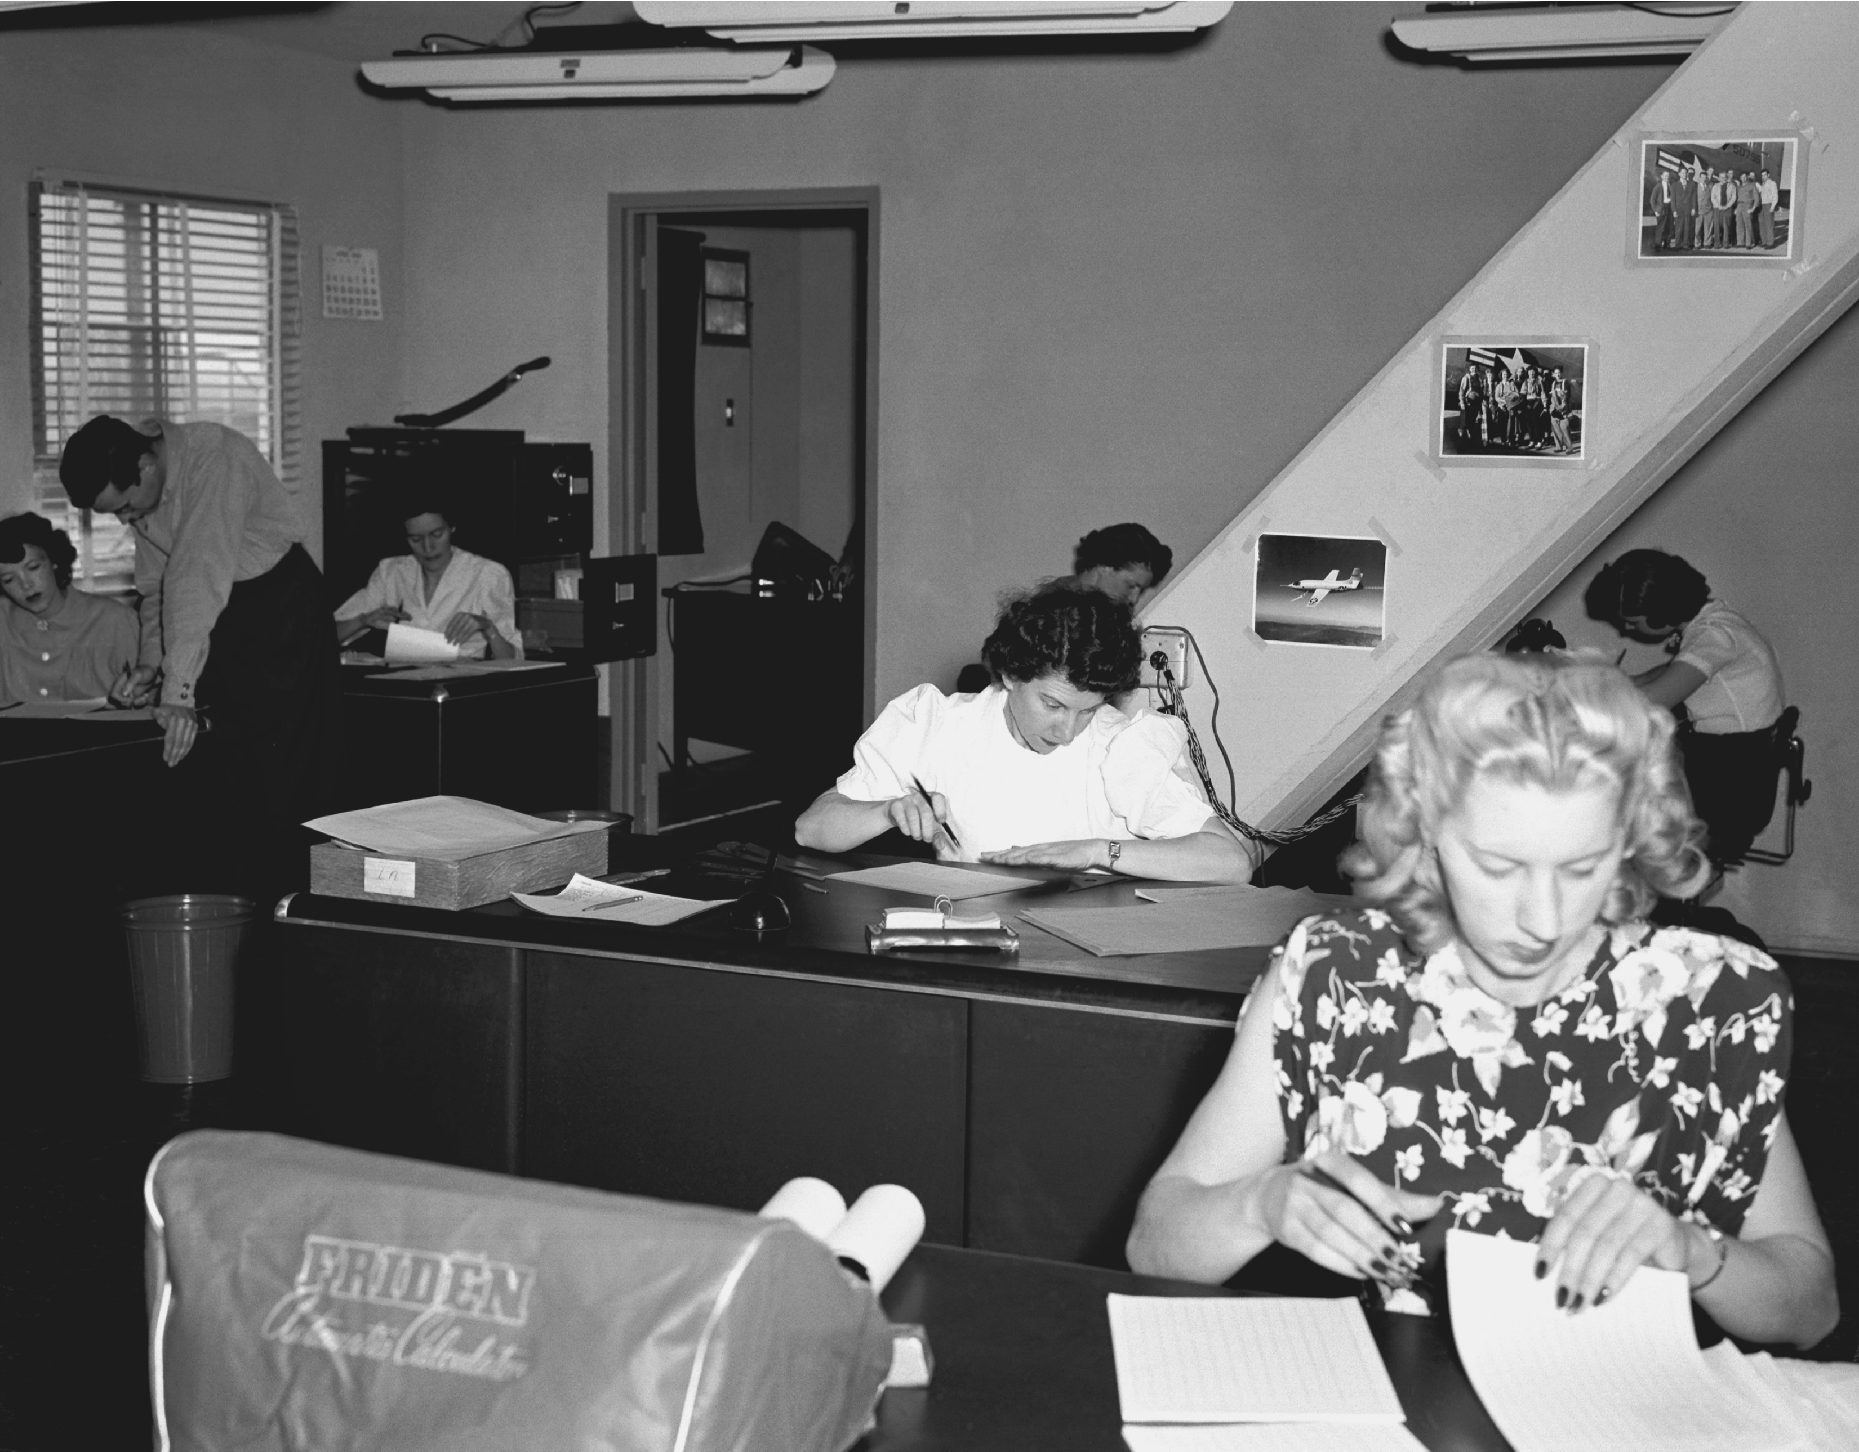
People!
Computers used to refer to people
In W W I I, computers were people who did difficult calculations by hand, for things like ballistic tables.

Slide 50
The Modern Computer

Slide 51
It’s all About the Switch
The basic component of most digital circuitry is nothing more complicated than a simple switch.
A switch’s function is pretty obvious, said in a number of different ways
On or Off
True or False
1 or 0

Slide 52
Electronic Switch
Early computers used vacuum tubes as switches
Later, transistors were used as substitutes

Slide 53
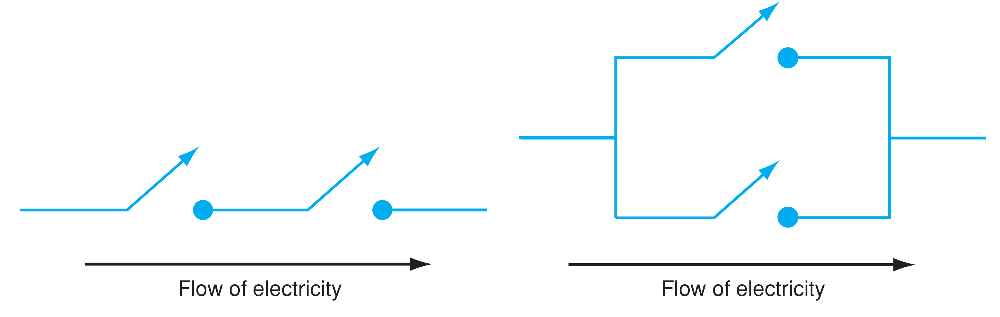
Switches for Boolean Circuits
Switches can be used to construct more complicated functions, such as Boolean circuits (and on left, or on right)

Slide 54
Transistor is the Key
Transistor is an electronic switch:
If gate has current, then signal flows from source to sink
If gate has no current, no flow
Figure 0.8 A diagram of a transistor and its equivalent “faucet” view.

Slide 55
But a Very Interesting Switch
Transistors have three interesting “features” that have made them the fundamental element of the computer revolution
Size
Quantity
Speed

Slide 56
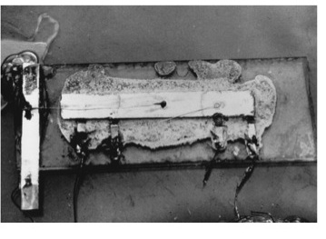
Size
Originally very large
Shockley transistor
Kilby integrated circuit

Slide 57
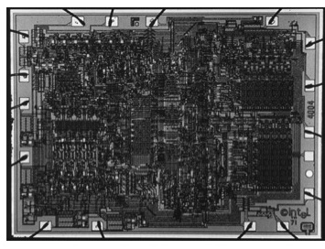
Intel’s First C P U
By 1971, Intel had created a “computer on a chip”, the 4004 microprocessor, the size of a fingernail with 2300 transistors

Slide 58
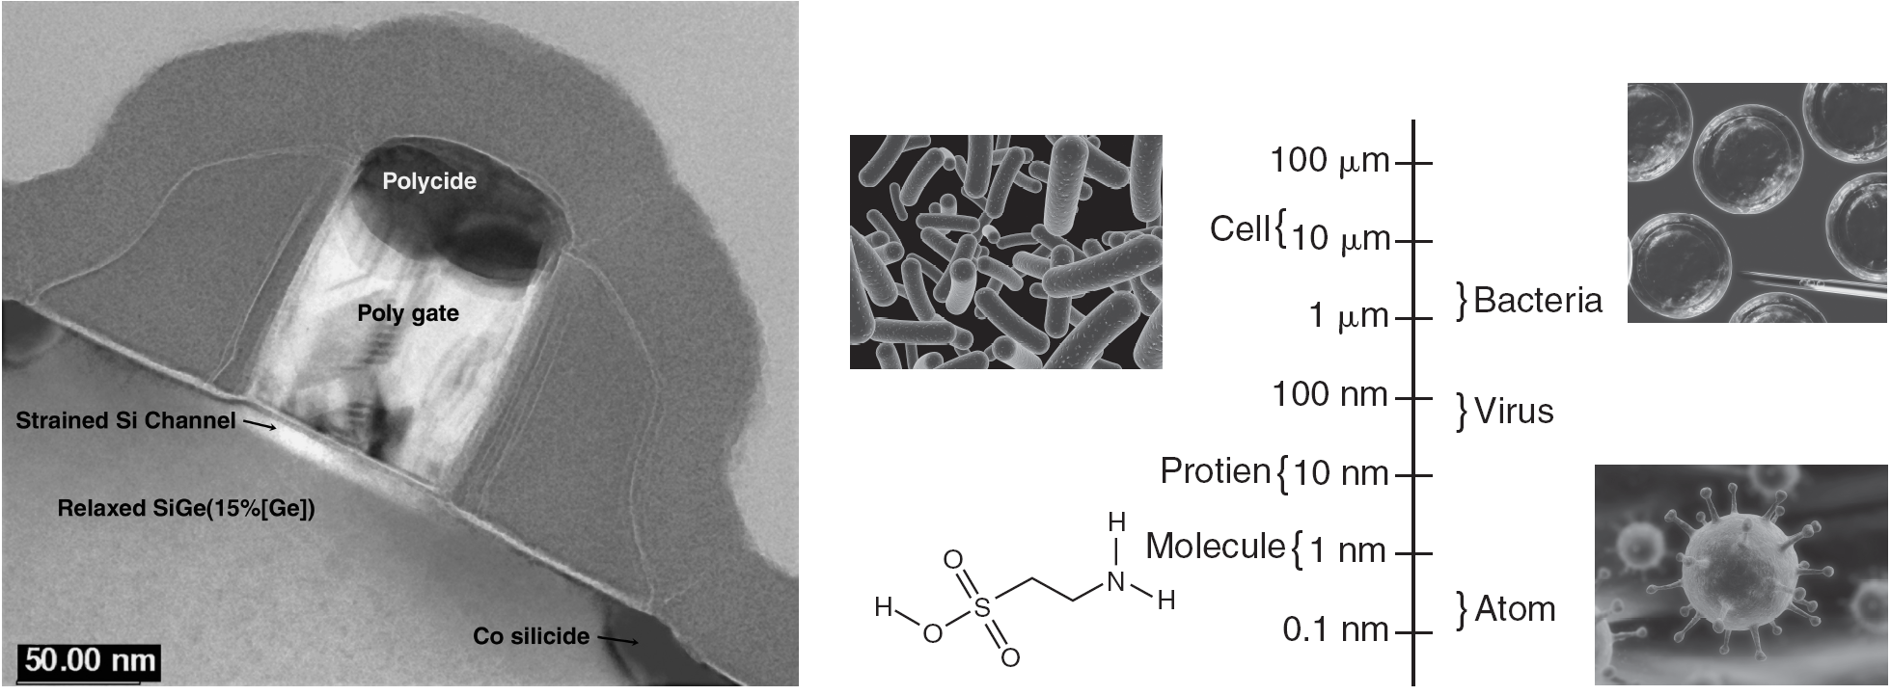
But Now, Really Small!
Chips now have gates measured in billionths of a meter (nanometers, nm)

Slide 59
Smaller Means More (1 of 2)
Table 0.1 Transistor counts in Intel microprocessors, by year.
Year | Transistor Count | Model
1917 | 2,300 | 4004
1978 | 29,000 | 8086
1982 | 134,000 | 80286
1986 | 275,000 | 80386
1989 | 1,200,000 | 80486
1993 | 3,100,000 | Pentium
1999 | 9,500,000 | Pentium III

Slide 60
Smaller Means More (2 of 2)
Year | Transistor Count | Model
2001 | 42,000,000 | Pentium 4
2007 | 582,000,000 | Core 2 Quad
2011 | 2,600,000,000 | 10-core Westmere
2014 | 3,000,000,000 | Apple A8X (iPad2)
2015 | 5,560,000,000 | 18-core Xeon Haswell

Slide 61
GPUs too!
Processor | Count | Date | Co. | Process | Area
G80 | 681,000,000 | 2006 | N V I D I A | 90 nm | 480 mm²
R V770 | 956,000,000 | 2008 | A M D | 55nm
G T200 | 1,400,000,000 | 2008 | N V I D I A | 55 nm | 576 mm²
H D5800 | 2,154,000,000 | 2009 | A M D | 40 nm | 334 mm²
G F100 | 2,900,000,000 | (future) | N V I D I A | 40 nm

Slide 62
Moore’s Law
Gordon Moore is one of the founders of the chip maker Intel
In 1965, he has observed (over that last 15 years or so) the growth rate of the number of transistors in a circuit
Made a famous prediction

Slide 63
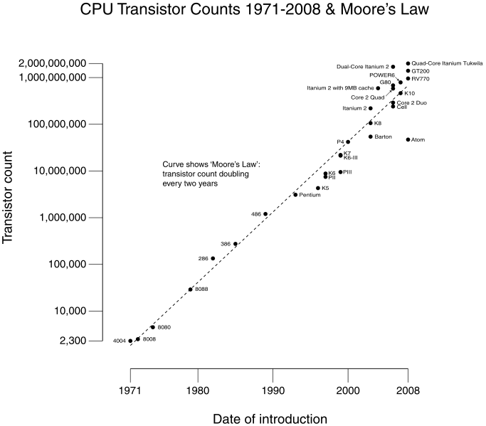
C P U Transistor Counts 1971-2008 and Moore’s Law

Slide 64
The “Law”
“The complexity for minimum component costs has increased at a rate of roughly a factor of two per year ... Certainly over the short term this rate can be expected to continue, if not to increase. Over the longer term, the rate of increase is a bit more uncertain, although there is no reason to believe it will not remain nearly constant for at least 10 years. That means by 1975, the number of components per integrated circuit for minimum cost will be 65,000. I believe that such a large circuit can be built on a single wafer”
Electronics Magazine 19 April 1965

Slide 65
What it Means
Roughly, since 1965, the number of transistors on a chip doubles every 18 months for approximately the same cost
Often quoted as the speed of a C P U doubling every 18 months for the same cost
speed and density were related

Slide 66
How Fast (1 of 2)
Typical processor this day runs at GHz speeds. That is 1 billion operations a second.
Year | CPU | Instructions/second | Clock Speed
1971 | Intel 4004 | 1 M I P S | 740 kHz
1972 | I B M System/370 | 1 M I P S | ?
1977 | Motorola 68000 | 1 M I P S | 8 M Hz
1982 | Intel 286 | 3 M I P S | 12 M Hz
1984 | Motorola 68020 | 4 M I P S | 20 M Hz
1992 | Intel 486D X | 54 M I P S | 66 M Hz
1994 | PowerP C 600s (G2) | 35 M I P S | 33 M Hz
1996 | Intel Pentium Pro | 541 M I P S | 200 M Hz
1997 | PowerP C G3 | 525 M I P S | 233 M Hz

Slide 67
How Fast (2 of 2)
Year | CPU | Instructions/second | Clock Speed
2002 | A M D Athlon XP 2400+ | 5,935 M I P S | 2.0 G Hz
2003 | Pentium 4 | 9,726 M I P S | 3.2 G Hz
2005 | Xbox360 | 19,200 M I P S | 3.2 G Hz
2006 | P S3 Cell B E | 10,240 M I P S | 3.2 G Hz
2006 | A M D Athlon F X-60 | 18,938 M I P S | 2.6 G Hz
2007 | Intel Core 2 Q X9770 | 59,455 M I P S | 3.2 G Hz
2011 | Intel Core i7 990x | 159,000 M I P S | 3.46 G Hz
2015 | Inel Core i7 5960X | 238,310 M I P S | 3.0 G Hz
How fast is a nanosecond?

Slide 68

Nanoseconds
Speed of light =186,000 miles/sec,
meters/sec (actually 299,792,458)
Thus 30 centimeters or 11.8 inches

Slide 69
Speed Pushing up Against Physics
The “clock” is like a drummer in the band. The faster it beats, the faster the operations.
In 1 clock tick (at 1 ghz), electricity can travel 1 ft. At 2ghz, 6 inches. At 4ghz, 3 inches
It becomes very difficult to get electricity to travel any distance in that short of time!

Slide 70
How to get Around Physics
So if physics is getting in the way (and it is), you find a way to get around it.
If you can’t make processors faster, what do you do?

Slide 71
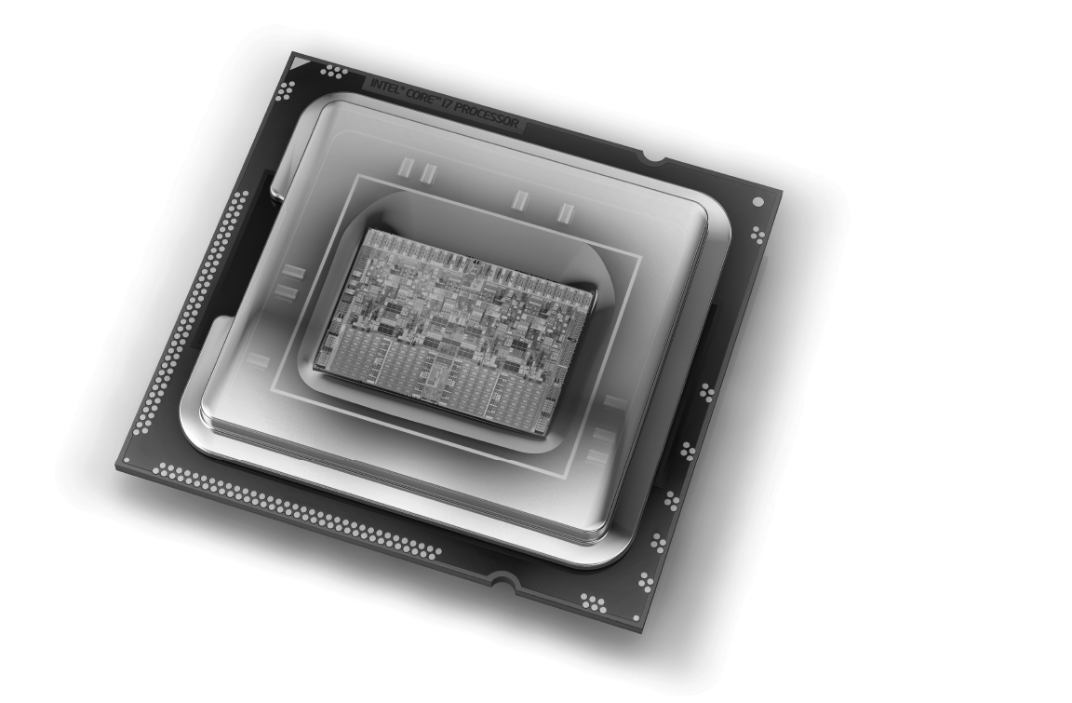
Not Faster, but More CPUs
Now more transistors mean more C P Us on a single chip. Below a quad-core C P U

Slide 72
Computer Parts

Slide 73
Main Components
People!!!
Hardware
Physical Devices: processor, memory, keyboard, monitor, mouse, etc.
Software
Executable Programs: word processor, spread sheet, internet browser, etc.

Slide 74
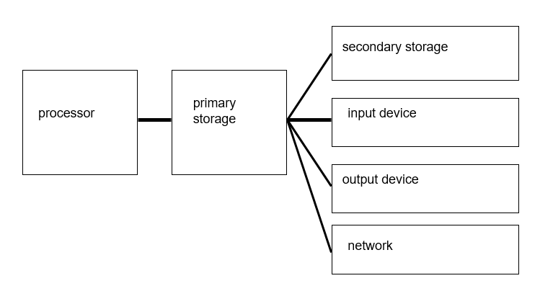
Hardware

Slide 75
Processor
The processor is the “brain”of a computer.
The processor controls the other devices as well as performing calculations

Slide 76
Primary Storage
stores instructions and data for current program(s)
other names: primary or main memory, R A M (Random Access Memory)
memory is dynamic so it requires power to retain information
often hundreds of Megabytes (million-bytes)

Slide 77
Peripheral Devices
Secondary storage devices
Disk (hard & floppy), tape, usb drives, flash drives, etc.
Input devices
Keyboard, mouse, camera, mic, etc.
Output devices
Monitor, printer, speaker, etc.
Network
Wireless, bluetooth, ethernet, etc.

Slide 78
Secondary Storage
Nonvolatile information is recorded magnetically so power is not needed
Disks hold gigabytes (billions of bytes)
Cheap, but slow
R A M access is a hundred C P U clock ticks
Disk access is a million C P U clock ticks
Not directly accessed by C P U

Slide 79
Software
The programs available for execution
Simple classification
System software
Application software

Slide 80
Fetch-Decode-Execute-Store
C P U operates on a simple (but fast) cycle:
Fetch: Fetch instruction from memory
Decode: Decode requirements (args, etc.)
Execute: Perform operation
Store: Move needed results to memory
Repeat

Slide 81
What is a Program?
A sequence of instructions written in machine language that tells the C P U to take action (i.e. add two numbers) in a specific order
In this course we will learn to create programs

Slide 82
Program Storage
Machine language instructions are encoded as bit patterns (binary, remember our transistors)
Memory can only hold binary info.
A bit is represented by two-states, e.G. L-R magnetism, high-low voltage
It takes many bits to represent reasonable amounts of information

Slide 83
Binary Numbers
The switch nature of transistors make storing numbers in binary a natural fit.
Binary is a change of base for our number system, base 2
In a number, its position represents powers of 2

Slide 84
Example
Decimal uses digits 0-9 and positions in a number as powers of 10
Binary users digits 0,1 and positions in a number as powers of 2
We can covert back and forth

Slide 85
Rule of Thumb: Binary to Decimal
The rule: Every 10 powers of 2 is about 3 powers of 10

Slide 86
Bits, Bytes and Words
Bit: a single 1,0
Byte: 8 bits
Word: A computer's standard unit of storage. A typical computer today is a 32 bit computer, meaning its word size is 32 bits (4 bytes)
Many newer processors are 64 bit!

Slide 87
Floating Point
The approximation of decimal point values such as 1.23, 0.01, 3.14159.
What is the exact value of
as a decimal point number?
It is an infinite sequence which we approximate when using a decimal number
Remember that floating point is approximate!

Slide 88
Representing Data in Binary
Letters are represented as numbers!
Both A S C I I and Unicode are encodings for particular letters.
A S C I I (American Standard Code for Information Interchange) was used for English letters. It is superseded by a subset of Unicode called U T F-8 (see appendix E)

Slide 89
UTF-8 table (First Few Rows)
Char | Dec | Char | Dec | Char | Dec | Char | Dec
N U L | 0 | SP | 32 | @ | 64 | ` | 96
S O H | 1 | ! | 33 | A | 65 | a | 97
S T X | 2 | " | 34 | B | 66 | b | 98
E T X | 3 | # | 35 | C | 67 | c | 99
E O T | 4 | $ | 36 | D | 68 | d | 100
E N Q | 5 | % | 37 | E | 69 | e | 101
A C K | 6 | & | 38 | F | 70 | f | 102
B E L | 7 | ' | 39 | G | 71 | g | 103
B S | 8 | ( | 40 | H | 72 | h | 104

Slide 90
Images (1 of 2)
Digital images consist of individual colors in a matrix.
Each individual color is called a pixel.
The color of a pixel can be encoded using numbers.

Slide 91
Images (2 of 2)
Figure 0.14 A computer display picture with a close-up of the individual pixels.
[Juliengrondin/Shutterstock]

Slide 92
Sound
We can sample a sound wave at a very high frequency and measure the height of the sound.
We can represent those measurements as numbers and use them to recreate a sound wave

Slide 93
Music
Figure 0.15 A sound wave and the samples of that sound wave (blue bar height) over time.

Slide 94
How Many Numbers

Slide 95
Binary
Byte = 8 bits
e.g. 10110010
Storage devices come in large quantities

Slide 96
Kilobyte (1000 bytes)
2 Kilobytes: A Typewritten page
10 Kilobytes: An encyclopedic page
50 Kilobytes: A compressed document
100 Kilobytes: A low-resolution photo

Slide 97
Megabyte (1 000 000 bytes)
1 MByte: A small novel or 3.5 inch floppy disk
2 MByte: A high resolution photograph
5 Mbyte: The complete works of Shakespeare
or 30 seconds of video
100 Mbyte: 1 meter of shelved books
500 Mbyte: A C D-R O M

Slide 98
Gigabyte (1 000 000 000 bytes)
1 GByte: A pickup truck filled with paper
or A symphony
or A movie
20 GBytes: the works of Beethoven as sound
50 GBytes: A library floor of books
100 Gbytes: standard Blu-ray capacity

Slide 99
Terabyte (1 000 000 000 000 byte)
1 TByte: All X-rays in a large hospital
or 50000 trees made into paper and printed
or Daily rate of E O S data (1998)
2 TBytes: An academic research library
20 Tb, photos/month on facebook
100 TBytes: The U S Library of Congress, all types of data, 2009
530 Tb, all videos on youtube
Notes:
EOS = Earth Observing System (NASA)

Slide 100
Terabyte In Your Hand (1 of 2)
Western Digital Caviar: 1 Terabyte, $269 (2006)
today, cost is $109
Seagate Barracuda, 1.5 Tb, $129

Slide 101
Terabyte In Your Hand (2 of 2)
History First disk by I B M in 1956 (4 M B on 50 24-inch platters) 1 G B in 35 years 500 G B in 14 more years 1000 G B = 1 TB in 2 more years

Slide 102
Petabyte = 1000 Terabytes* = 1,000,000 Gigabytes
E M C Symmetrix D M X-3 1.2 PB = 2400 500GB drives ($4 million 2006)
Backblaze (build your own), $120,000, 2009
Kazza shared 54 Petabytes (2005)
Google cluster has 4 Petabytes of R A M, processes 20 Pb a day
All data recorded in 2003: 2500 Petabytes
WoW, 1.3 Pb to maintain its game

Slide 103
Petabyte? (1 of 3)
In round numbers, a book is a megabyte. If you read one book a day for every day of your life for 80 years, your personal library will amount to less than 30 gigabytes. Remember a petabyte is 1 million gigabytes so you will still have 999,970 gigabytes left over.
How many pictures can a person look at in a lifetime (4 Mbytes each)? I can only guess, but 100 images a day certainly ought to be enough for a family album. After 80 years, that collection of snapshots would add up to 30 terabytes. So your petabyte disk will have 970,000 gigabytes left after a lifetime of high quality photos and books.

Slide 104
Petabyte? (2 of 3)
What about music? M P3 audio files run a megabyte a minute, more or less. At that rate, a lifetime of listening-24 hours a day, 7 days a week for 80 years-would consume 42 terabytes of disk space. So with all your music and pictures and books for a lifetime you will have 928,000 gigabytes free on your disk.

Slide 105
Petabyte? (3 of 3)
The one kind of content that might possibly overflow a petabyte disk is video. In the format used on D V Ds, the data rate is about two gigabytes per hour. Thus the petabyte disk will hold some 500,000 hours worth of movies; if you want to watch them all day and all night without a break for popcorn, they will actually fill up your petabyte drive if you have a lifetime of video on it as it will give you 57 years of video

Slide 106
Exabyte (1 000 000 000 000 000 000 bytes)
5 Exabytes: All words ever spoken (as text) by human beings.
5-8 Eb, global internet traffic monthly
500 Eb, total world digital content (2009)

Slide 107
Zettabyte (1021) 1,000,000,000,000,000,000,000
Audio of everything ever spoken, by anyone, at anytime in history, 16K Hz, 16 bit audio: 42 Zb

Slide 108
How Much Data Is That?
Figure 0.16 Estimates of data created and stored. (IDC Digital Universe)

Slide 109
The Rules
Think before you program
A program is a human-readable essay on problem solving that also happens to execute on a computer.

Slide 110

Copyright

